Slide 1
1st Internal Check
Pinocchio
Minjin Gu , Tiffany Yang, Sungbin Yoon
Stanley Chan, Adhya Bansal, Sanjana Manikandan

Slide 2
Table of Contents
2. Impact and Implementation
Software Application
3. User Feedback

Slide 3
Overview of Pinocchio
Aim
Build a supportive community for students with mental health issues
Target Users
Format of Interaction
HKUST students who are mainly suffering from mental health issues
Online forum website composed of students’ forum
How to improve mental health of HKUST students
Online forum to help each other by providing helpful information related to mental health issues

Slide 4
Meeting the Needs of Community
Customised to HKUST students
Since Wellness center’s coverage and efficiency are low, can increase coverage if students help each other
Login with ITSC email address and set up an Instagram page to only allow Pinocchio among the community of HKUST students
Notes:
So how is our project customized and meeting the needs of the HKUST students? paUST is the only IG platform offered by the HKUST that tackles mental health issues. However, IG is one-way communication and has a long response time. Also, although the Wellness Center offers various services including peer counseling sessions, not many students were utilizing the service. On top of that, due to the existing stigma around mental health and the top-down approach of the counseling system, the system is not as efficient for those students who are on the verge of falling into the severe cycle of mental health. So as Sungbin mentioned, we would like to launch Pinocchio to help those HKUST students who are hesitant to reach out to the Wellness Center but want to express their feelings anonymously.

Slide 5
01.
Software Application
Pinocchio

Slide 6
Meeting Needs of Community: Features
Home Page
Interests
Bookshelf & Online Forum
Bookmark
Writing
My Stories
Personal Page
Guide & Rules

Slide 7
02.
Design Demo
https://www.figma.com/file/9oh3Zpdupih2LqxGsDZIS7/Pinocchio-Web-Design?node-id=0%3A1

Slide 8
Initial Development of Pinocchio
Notes:
demo

Slide 9
01.
2. Impact and Implementation
Pinocchio

Slide 10
Main Objectives/Tasks
Engagement
Moderators
engaging with the forum users through replies on posts, comments, etc.
Peer counselors and mentors will be able to act as moderators for the website in order to keep with the guidelines
Personal Experiences
Forum should include posts/threads with issues or struggles that peer counselors or mentors have faced with mental health

Slide 11
Our Plan
Engage UST community after beta-testing
Marketing from May 15, 2021
Launch date ~ May 29, 2021

Slide 12
Timeline
Week 6 (this week)
Week 7
Week 8/9
Show prototype and initial objectives to SIGHT advisors
Advisor Meeting Report and Feedback on Website
2nd internal check + finished prototype ready for beta-testing with approximately 20 users
Week 10/11
Week 12
Roadshow preparation + marketing Pinocchio to HKUST
Roadshow. Website will be launched either the day of or a couple of days before

Slide 13
Behavioral Changes

Slide 14
Openness of the discussion
surrounding mental health
—John Cage
The growth of our platform
Number of Registered Users
Number of Monthly Posts
Average number of Responses to Posts
Surveys

Slide 15
Normalising Asking For Help
Books are most of the time one of the safest choices
Movies are a good source of fantasy and actual facts
In this era of globalization, internet is a very powerful resource

Slide 16
Students reflecting on their emotions

Slide 17
01.
3. User Feedback
Pinocchio

Slide 18
The Expectations
A “reason to share”
Why share on this platform instead of friends?
An anonymous page where everyone can share their stories freely
Facebook’s Emojis - Love, angry and etc
Able to meet/talk to people with same mental health problems

Slide 19
01.
3.1 Mobile Version
Pinocchio

Slide 20
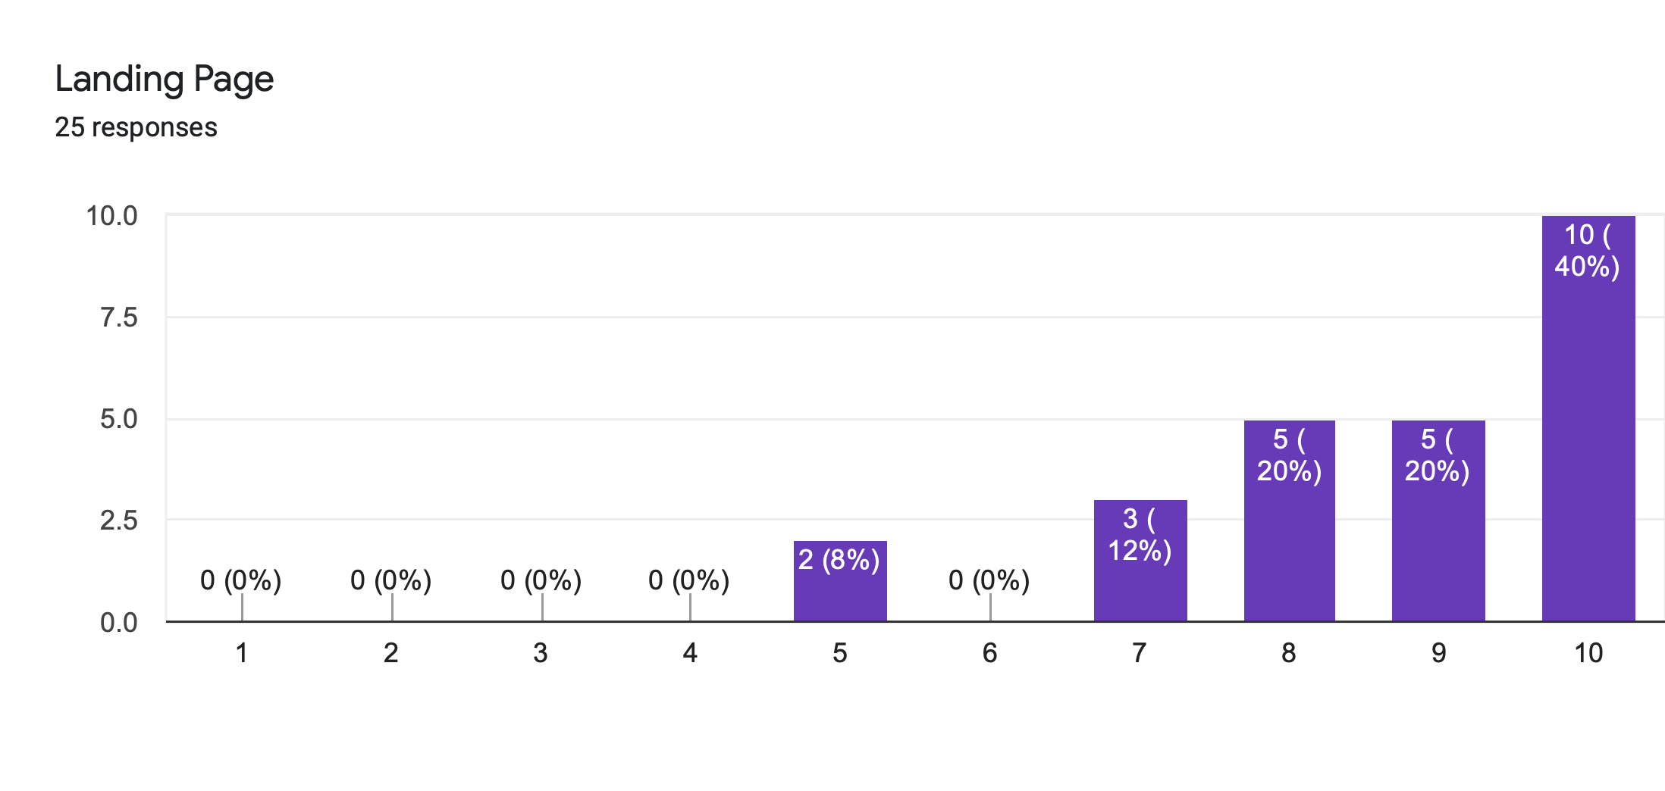
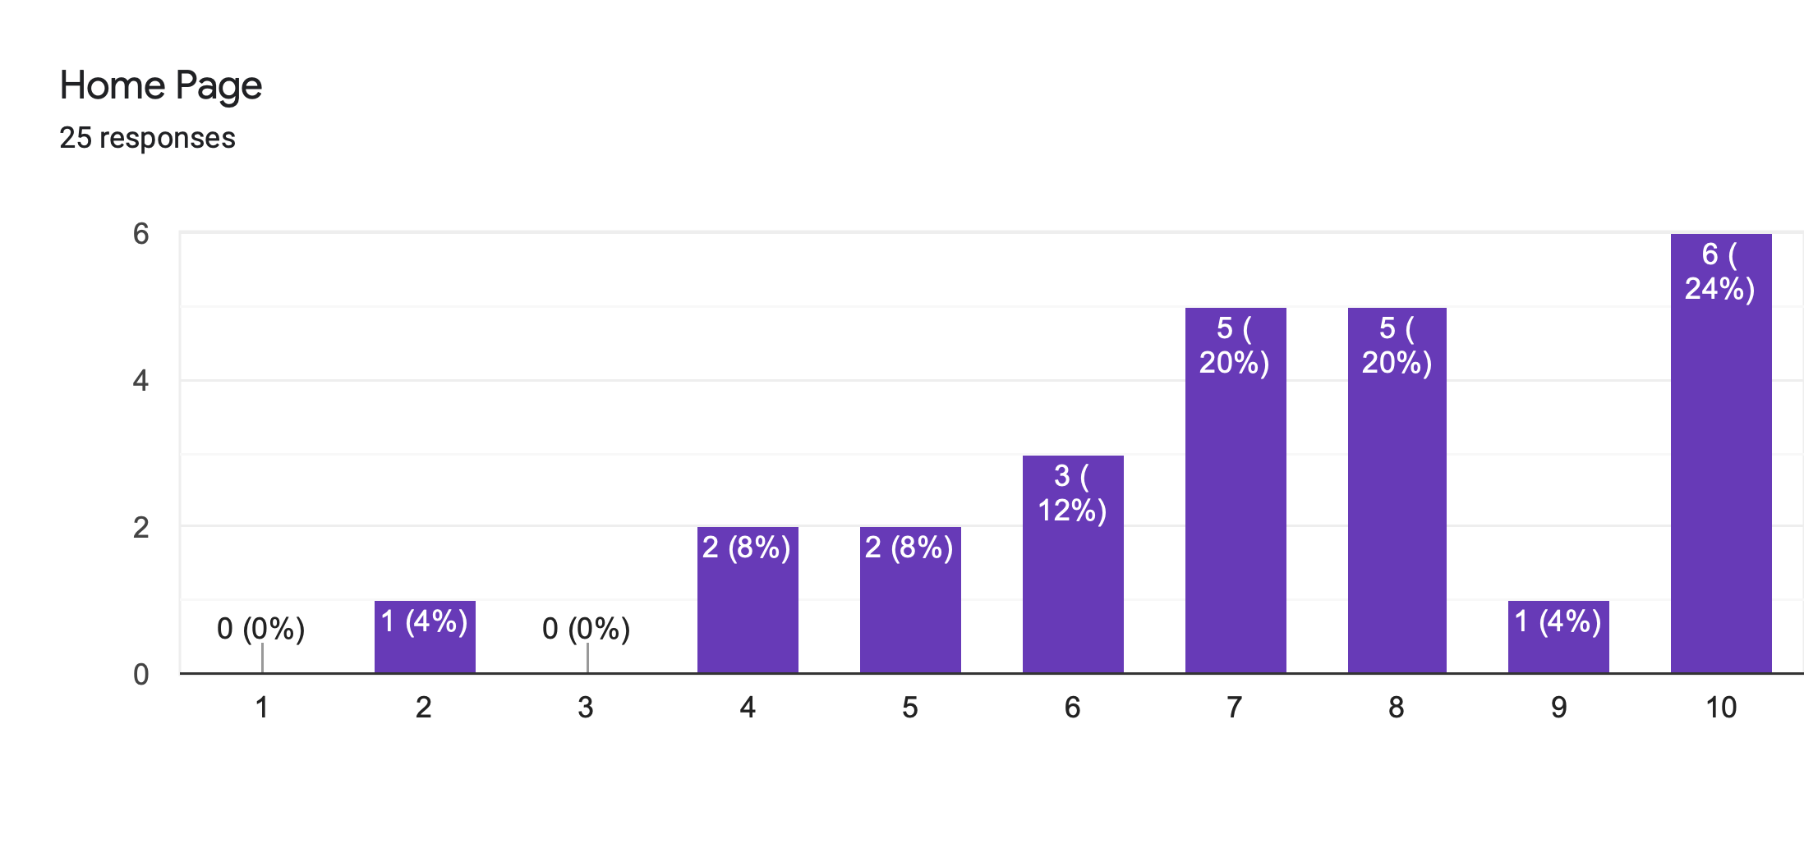
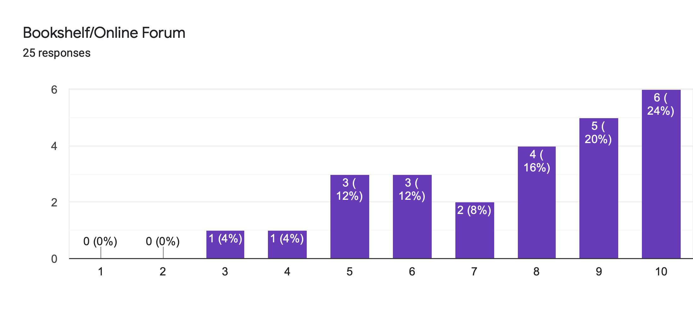
Survey Results

Slide 21
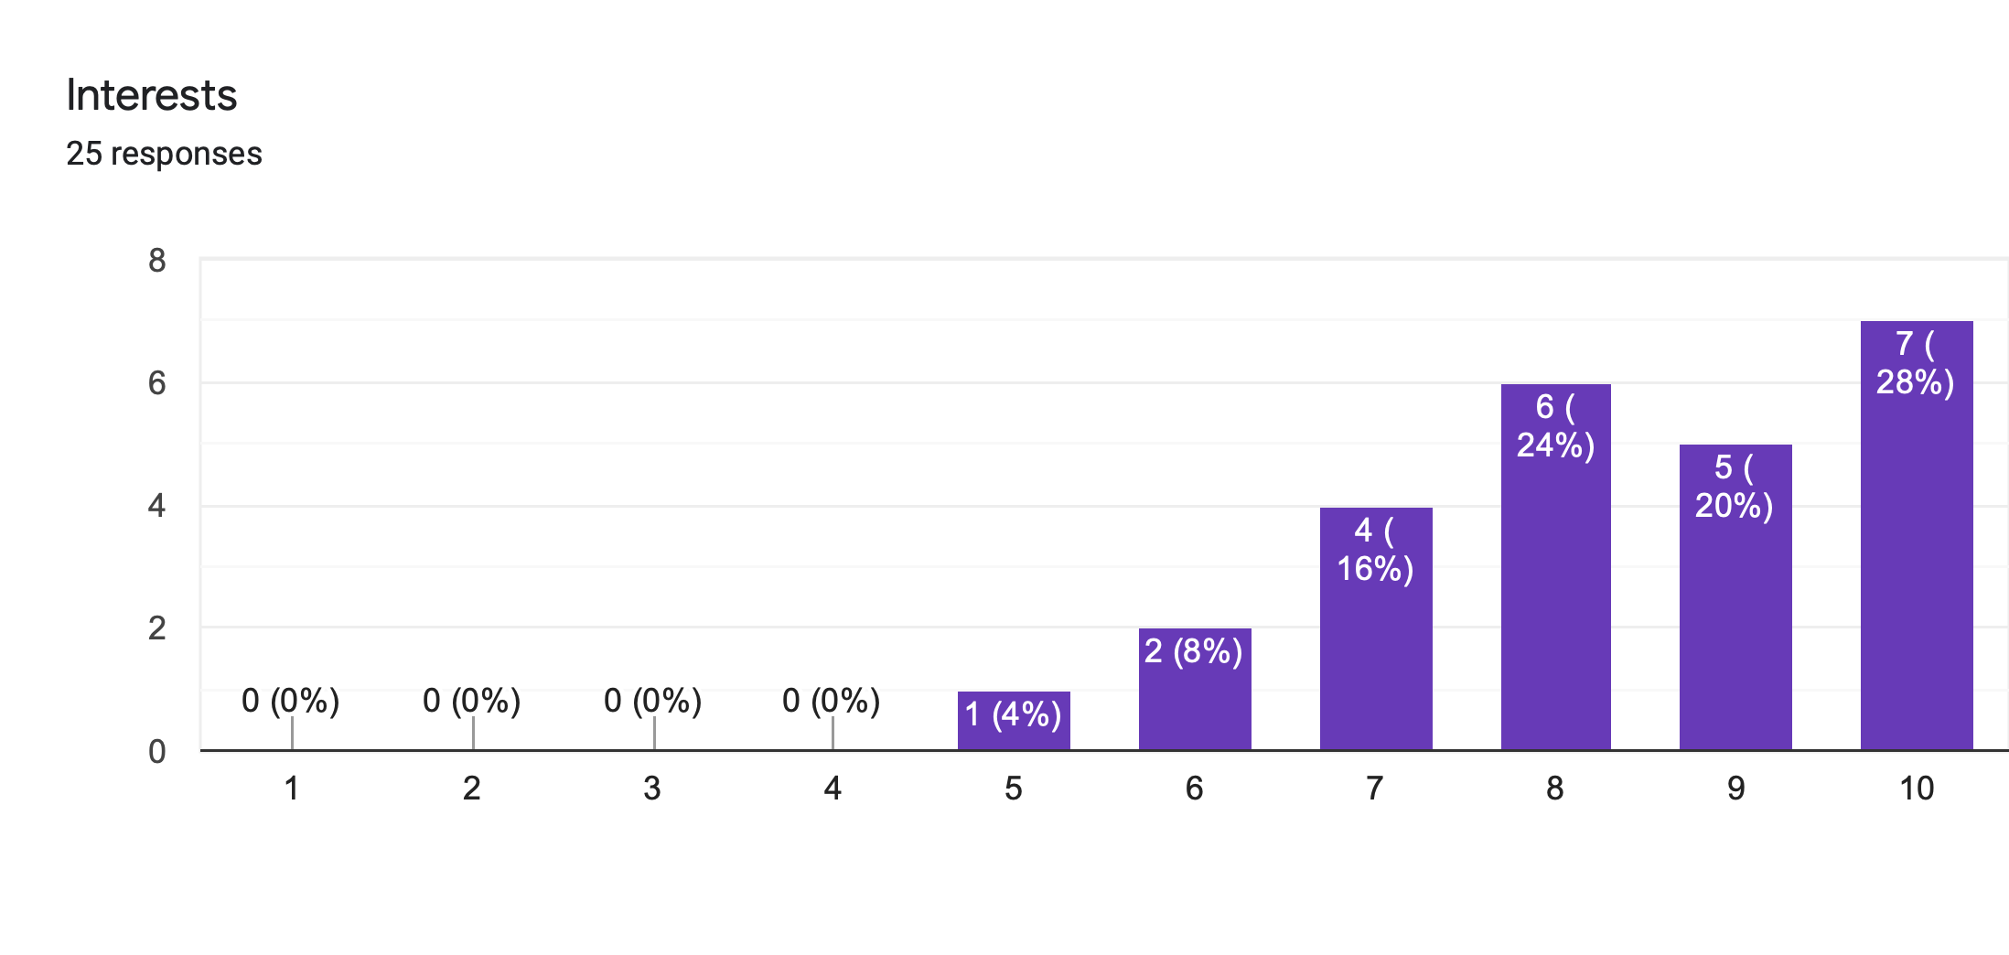
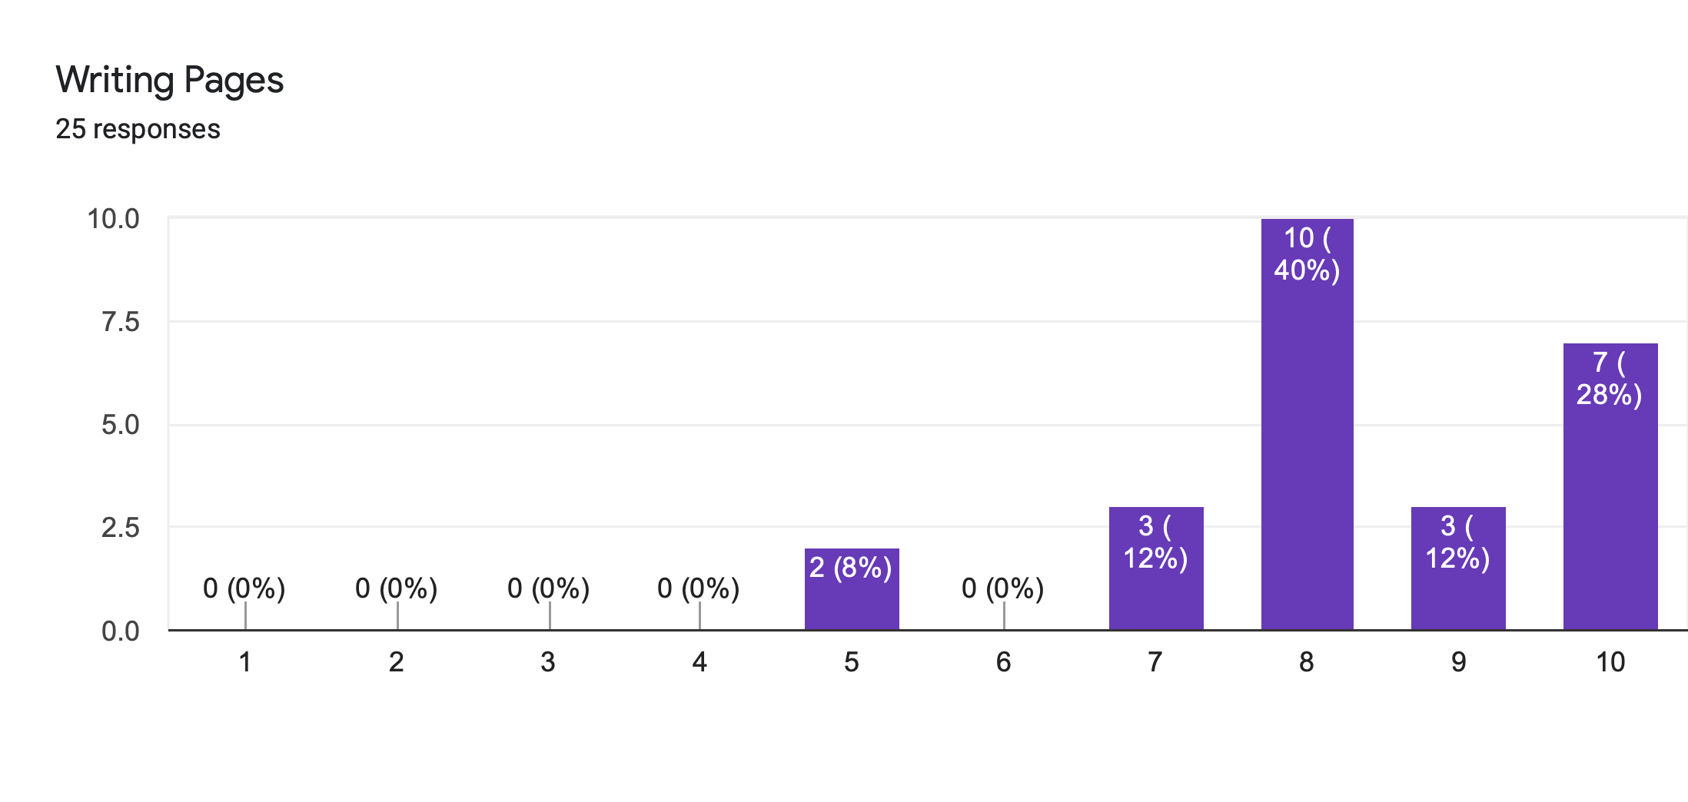
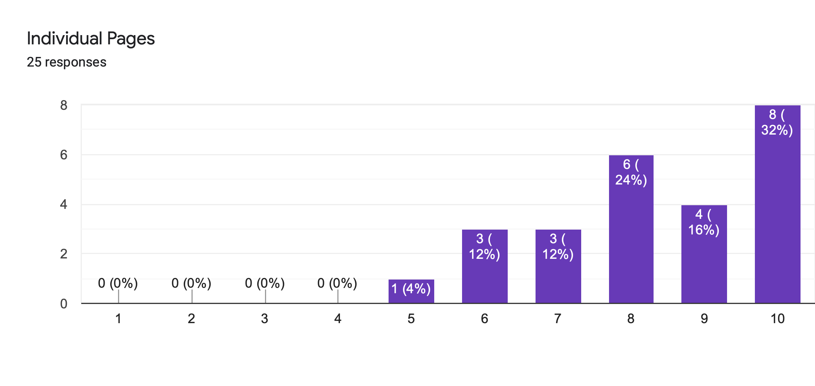
Survey Results

Slide 22
Survey Results
—John Cage
Page Name | Average Score (Out of 10)
Landing Page | 8.64
Home Page | 7.28
Bookshelf/ Online Forum | 7.64
Individual Pages | 8.32
Interests | 8.32
Writing Page | 8.32

Slide 23
Main Takeaways (Mobile):
Interview & Short Answer
—John Cage
Overall: Positive Feedback
Criticisms:
Theme
Too fancy looking
Structure/ Text:
A bit too packed & buttons are not clear at first
Text do not match curves
Consistency in font type
Better readability than web version

Slide 24
01.
3.2 Web Version
Pinocchio

Slide 25
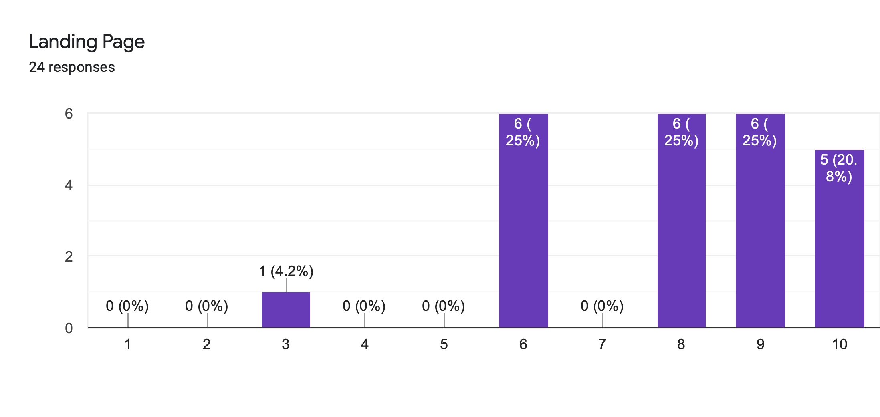
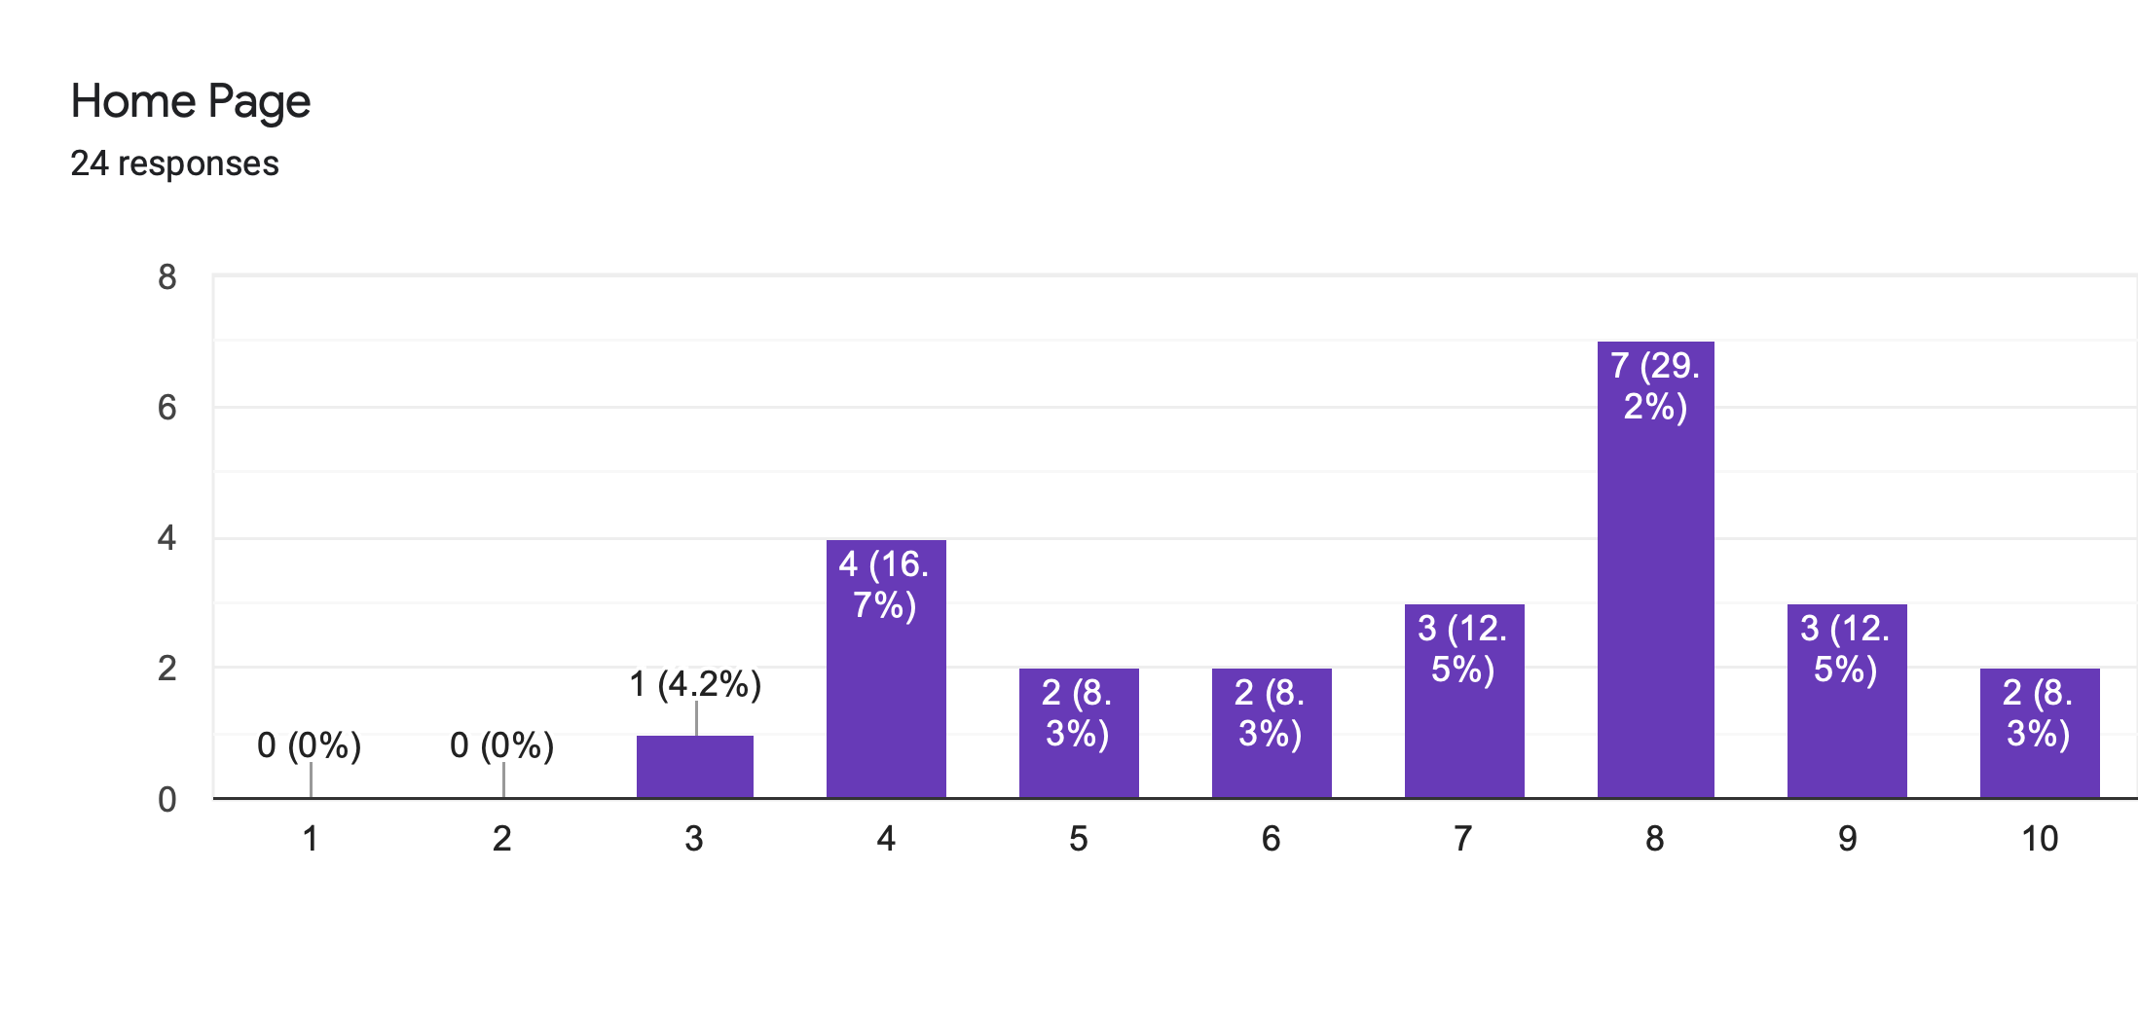
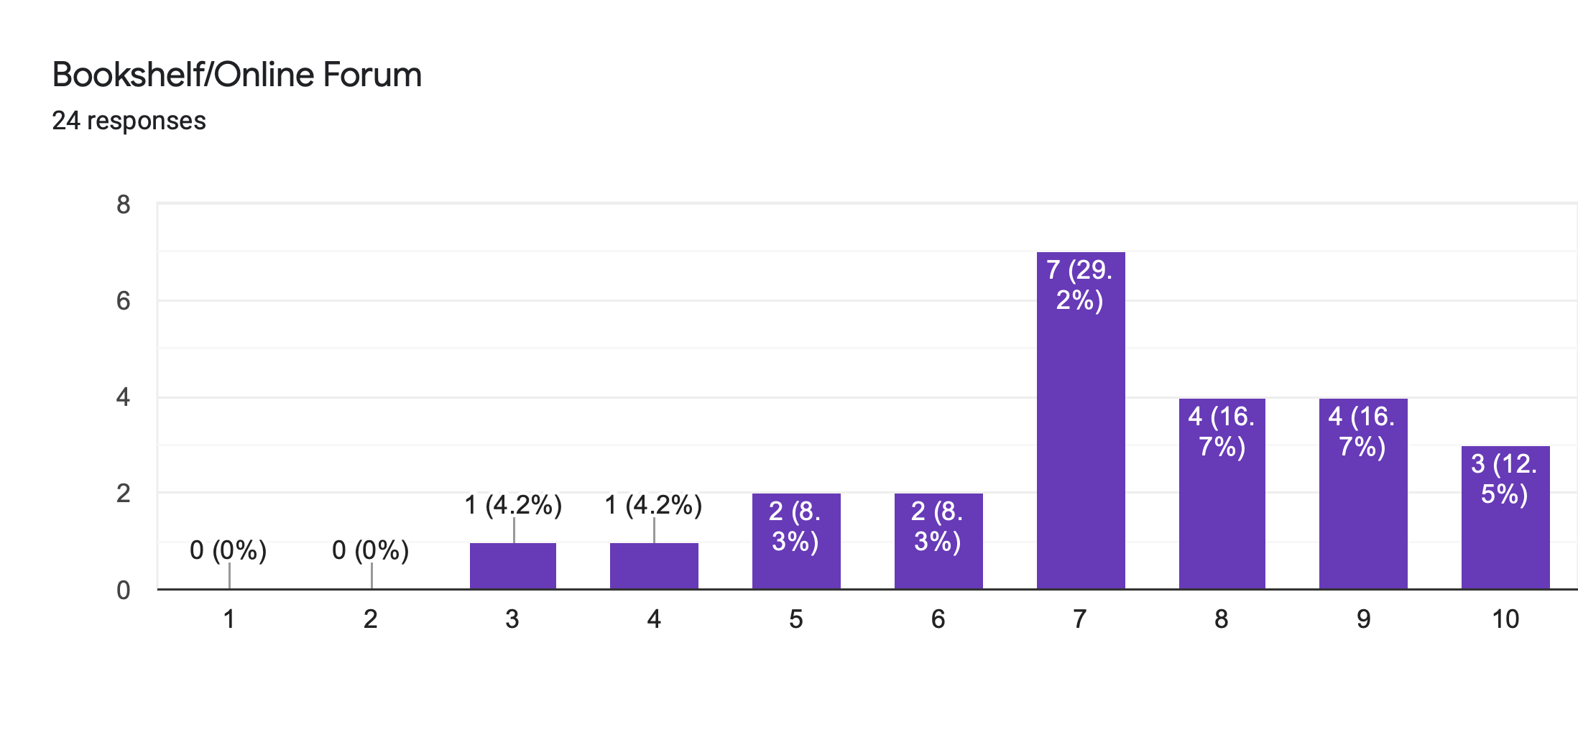
Survey Results

Slide 26
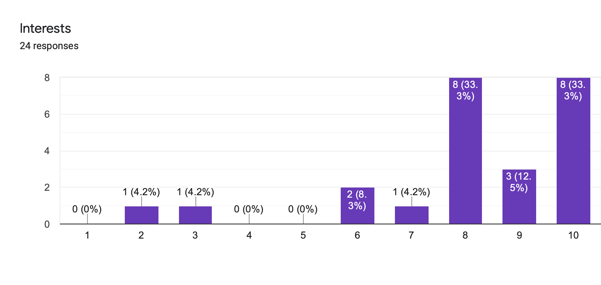
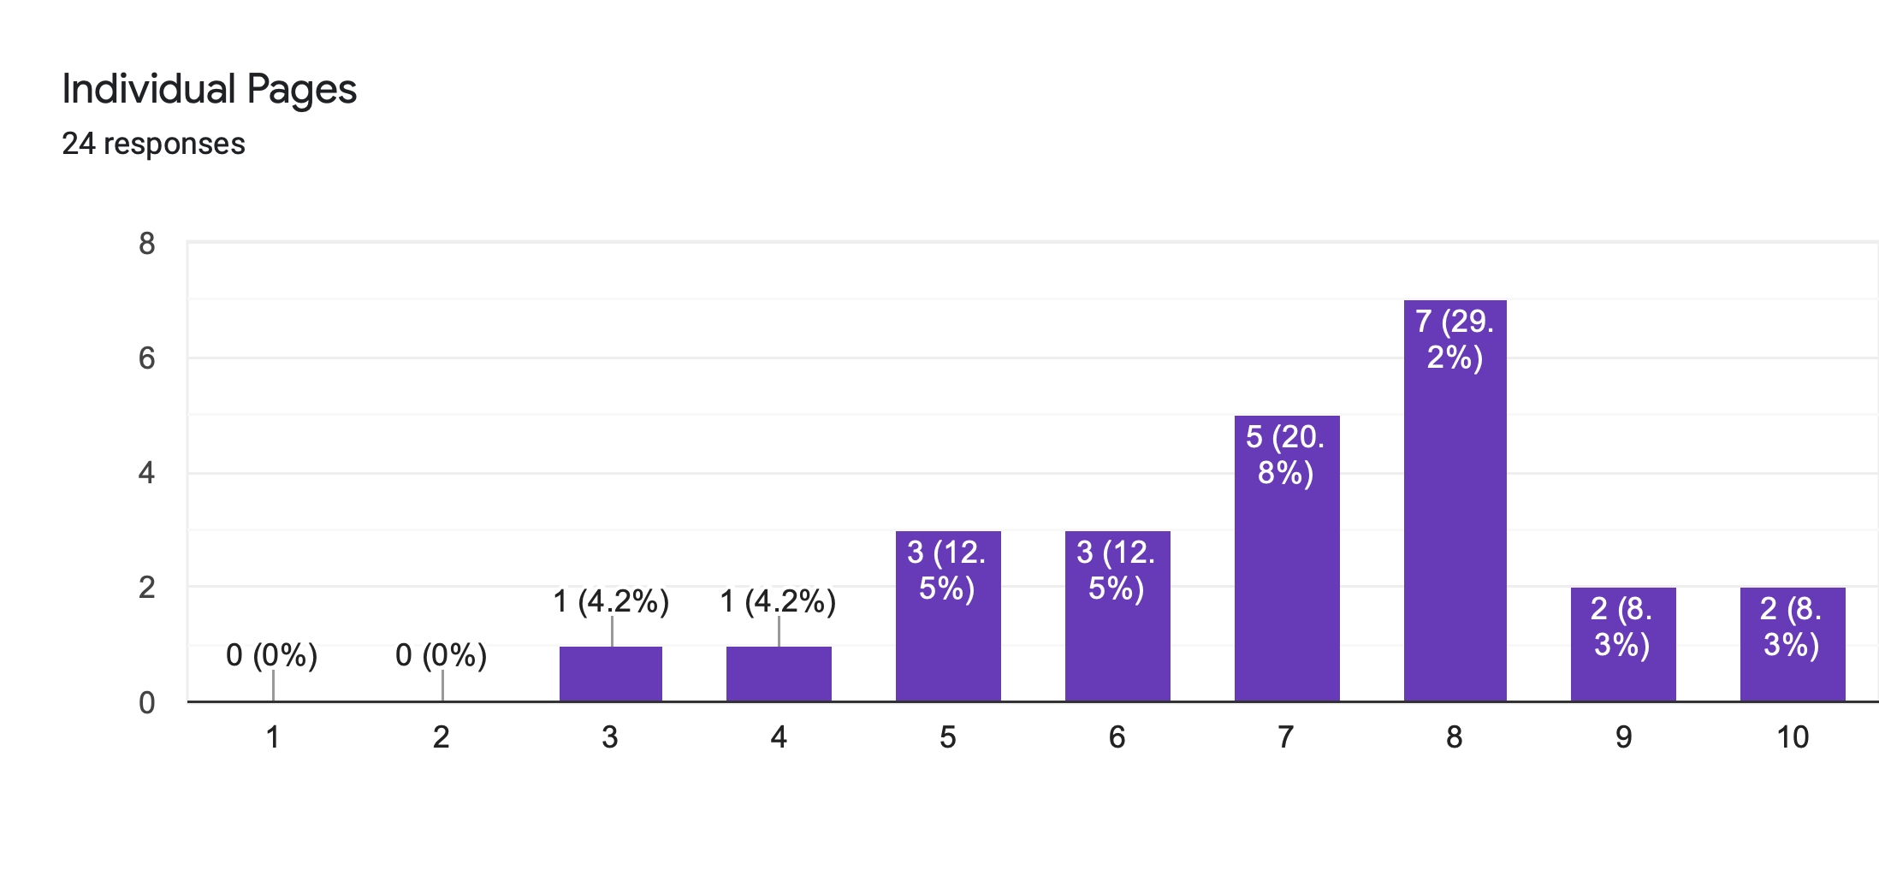
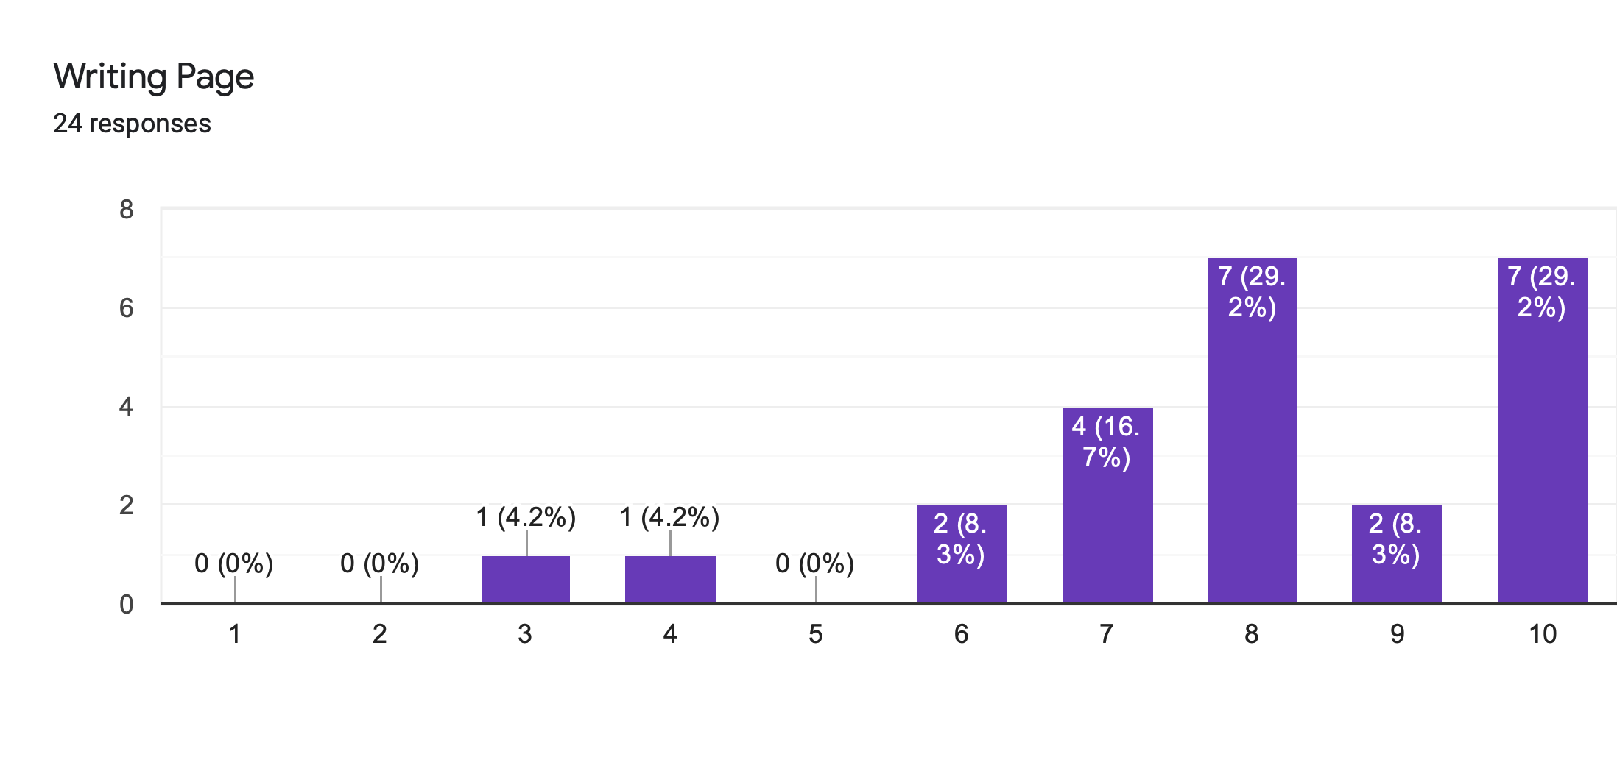
Survey Results

Slide 27
Survey Results
—John Cage
Page Name | Average Score (Out of 10)
Landing Page | 7.96
Home Page | 6.88
Bookshelf/ Online Forum | 7.33
Individual Pages | 7.04
Interests | 8.13
Writing Page | 7.96

Slide 28
Main Takeaways (Web):
Interview & Short Answer
—John Cage
Overall: Positive Feedback
Criticisms:
Theme
Color is too energetic
Avoid using too much cartoon
Structure/ Text:
Bookshelf text hard to read
Bigger font preferred
Text curve do not march curves

Slide 29
General Comments
—John Cage
Pinocchio-related jokes are interesting (More preferred)
Mixed opinion on font choice
Homepage icons needs to be better positioned
Mix of skeuomorphic & minimalistic design
Mix of capitalised & not capitalised text
Design language is too cartoon-ish (Platform looks too child-like)

Slide 30
Suggestions for Features
Mindfulness Training/ Tips to Improve Mental Health
Reference Link to Third Party (Counselling)
More Self-Help Guides & Links to Videos
AI Chatbot
Jokes to Lift People Up

Slide 31
Thanks!

